Slide 1
Microcontroller Based System Design
CSE 3216
LAB 2

Slide 2
Keypad

Slide 3
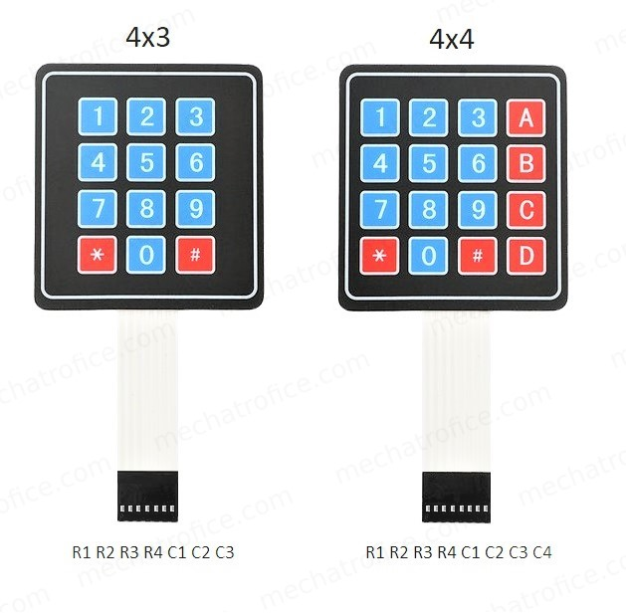
Keypad

Slide 4
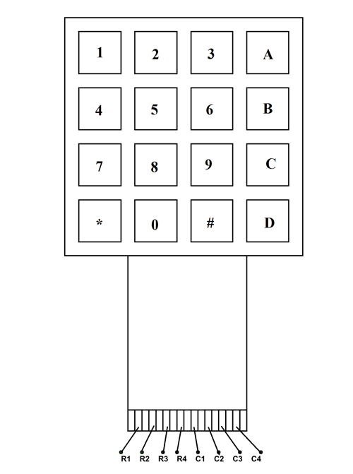
4x4 Keypad: Pin Layout
LEFT TO RIGHT->
1ST 4 PINS: ROWPINS
(R1, R2, R3, R4)
LAST 4 PINS: COLPINS
(C1, C2, C3, C4)

Slide 5
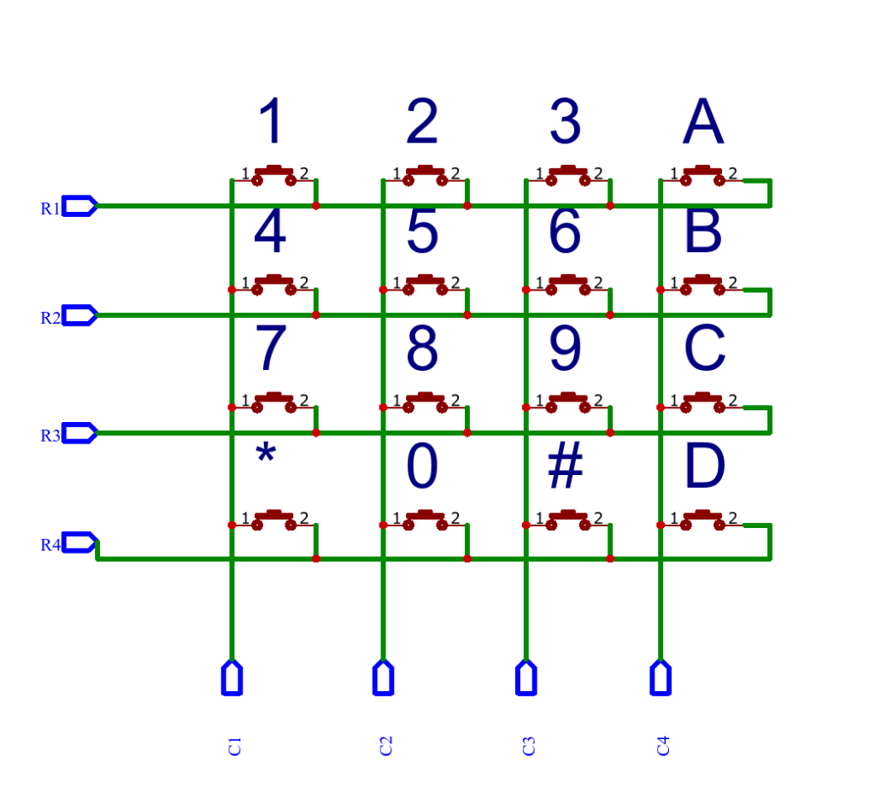
Keypad (contd)

Slide 6
Adding Libraries to Arduino
“Sketch” Button-> “Include Library”-> “Manage Libraries”-> Search for the library you need [in this case, “Keypad”]

Slide 7
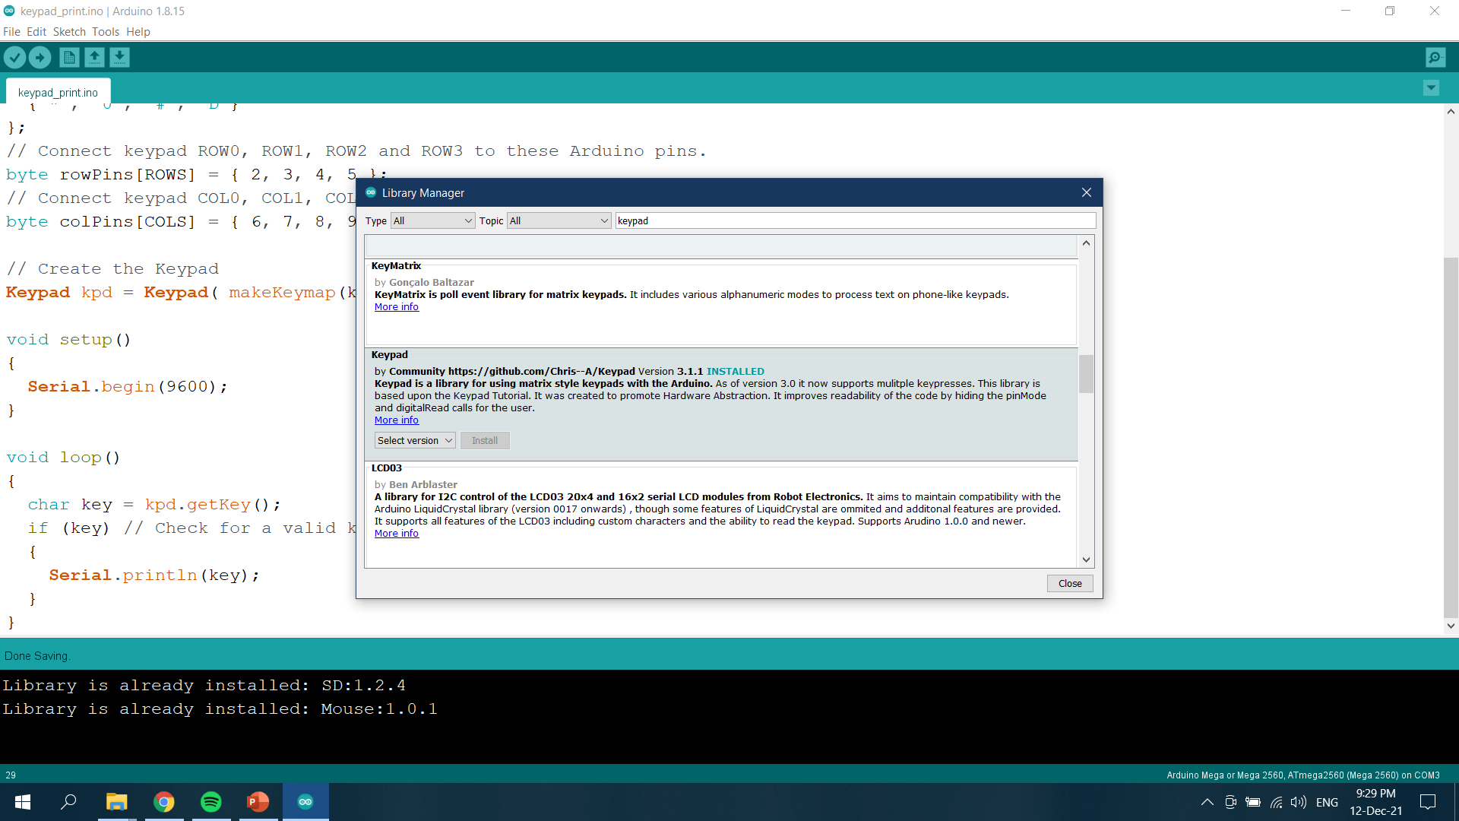

Slide 8
Keypad Functions
makeKeymap(keys): This function is used to initialize the internal keymap to be equal to the user defined key map.
Keypad kpd = Keypad(makeKeymap(keys), rowPins, colPins, rows, cols):
This defines an object kpd of the class Keypad and initializes it.
rowPins and colPins are the pins on Arduino to which the rows and columns of the keypad are connected to.
rows and cols are the number of rows and columns the keypad has.
kpd.getKey(): This function is used to identify which key is pressed on the keypad.

Slide 9
Serial Communication
Serial Communication: Used for communication between the Arduino board and a computer or other devices.
On Uno, Nano, Mini, and Mega, pins 0 and 1 are used for communication with the computer. Connecting anything to these pins can interfere with that communication, including causing failed uploads to the board.

Slide 10
Serial Functions
Serial.begin(): Sets the data rate in bits per second (baud) for serial data transmission. Typically, 9600 baud is used.
Syntax: Serial.begin(9600);
Serial.print(): Prints data to the serial port as human-readable ASCII text.
Syntax: Serial.print(“string”);
Serial.println(): Prints data to the serial port as human-readable ASCII text followed by a carriage return character ('\r') and a newline character ('\n').
Syntax: Serial.print(“string”);

Slide 11
Connection to Arduino
Connect the 1st four pins (from the left) to the rowPins mentioned in the Arduino code
Connect the last four pins to the colPins mentioned in the Arduino code

Slide 12
Arduino Code
#include <Keypad.h>
const byte ROWS = 4; // Four rows
const byte COLS = 4; // Four columns
char keys[ROWS][COLS] = {
{'1', '2', '3', 'A'},
{'4', '5', '6', 'B'},
{'7', '8', '9', 'C'},
{'*', '0', '#', 'D'}
};
// Connect keypad ROW0, ROW1, ROW2 and ROW3 to these Arduino pins.
byte rowPins[ROWS] = { 2, 3, 4, 5 };
// Connect keypad COL0, COL1, COL2 and COL3 to these Arduino pins.
byte colPins[COLS] = { 6, 7, 8, 9};

Slide 13
Arduino Code(contd)
// Create the Keypad
Keypad kpd = Keypad( makeKeymap(keys), rowPins, colPins, ROWS, COLS );
void setup()
{
Serial.begin(9600);
}
void loop()
{
char key = kpd.getKey();
if (key) // Check for a valid key.
{
Serial.println(key);
}
}

Slide 14
Buzzer

Slide 15
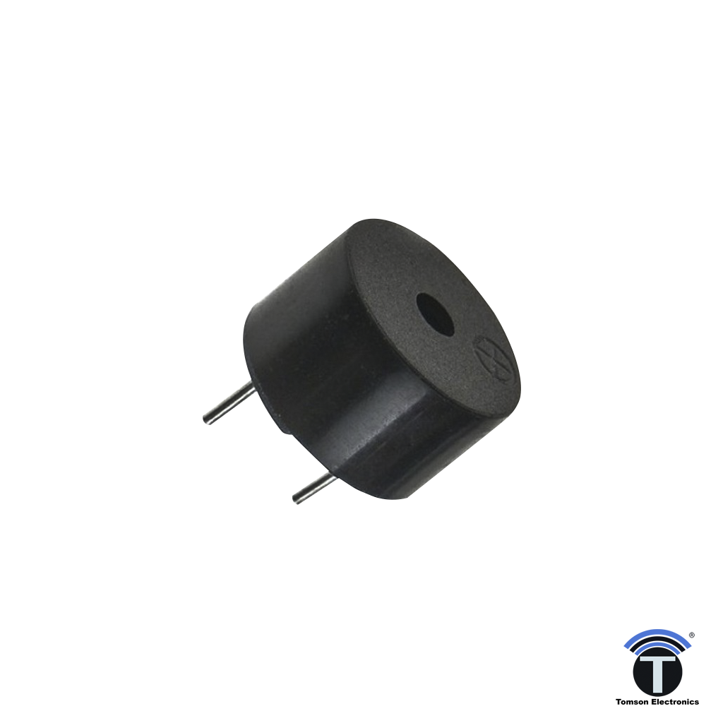
Buzzer
Piezo buzzer is an electronic device commonly used to produce sound.
Piezo buzzer is based on the inverse principle of piezo electricity discovered in 1880 by Jacques and Pierre Curie. It is the phenomena of generating electricity when mechanical pressure is applied to certain materials and the vice versa is also true. Such materials are called piezo electric materials.

Slide 16
Buzzer(contd)
Piezoceramic is class of manmade piezoelectric material, which poses piezo electric effect and is widely used to make “disc”, the heart of piezo buzzer. When subjected to an alternating electric field they stretch or compress, in accordance with the frequency of the signal thereby producing sound.

Slide 17
Buzzer Functions
tone():
Description
Generates a square wave of the specified frequency on a pin. A duration can be specified, otherwise the wave continues until a call to noTone().
Syntax
tone(pin, frequency)
tone(pin, frequency, duration)
Parameters
pin: the Arduino pin on which to generate the tone.
frequency: the frequency of the tone in hertz. Allowed data types: unsigned int.
duration: the duration of the tone in milliseconds (optional). Allowed data types: unsigned long.

Slide 18
Buzzer Functions
noTone():
Description
Stops the generation of a square wave triggered by tone(). Has no effect if no tone is being generated.
Syntax
noTone(pin)
Parameters
pin: the Arduino pin on which to stop generating the tone

Slide 19
Connection to Arduino
Connect the positive pin of the buzzer to the Digital Pin (no. mentioned in the code) of the Arduino through a small valued resistor.
Connect the negative/ground pin of the buzzer to any Ground Pin on the Arduino.

Slide 20
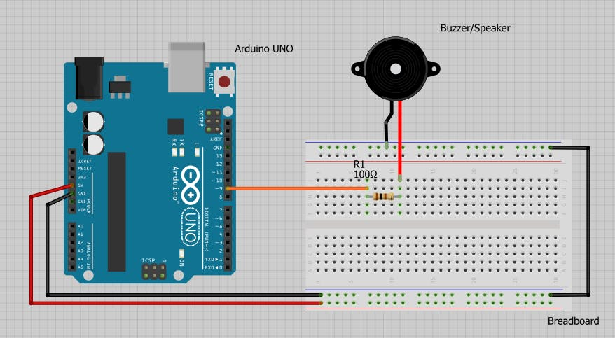

Slide 21
Arduino Code
int buzzer = 9; //buzzer to arduino pin 9
void setup(){
pinMode(buzzer, OUTPUT); // Set buzzer - pin 9 as an output
}
void loop(){
tone(buzzer,1000); // Send 1KHz sound signal...
delay(1000); // ...for 1 sec
noTone(buzzer); // Stop sound...
delay(1000); // ...for 1sec
}

Slide 22
THE END

